Slide 1
YOUTUBE VIDEO SUMMARIZER
Shalu Priya R
KGISL Institute Of Technology NM ID: au711721243097
4/10/2024Annual Review
1

Slide 2


AGENDA
Problem Statement Project Overview
Who are the end users
Solution and its value propostion Solution
Modelling Results
4/10/2024Annual Review
3

Slide 3

PROBLEM STATEMENT
Users often face information overload when browsing through countless videos on YouTube, making it challenging to identify relevant content.
Traditional methods of summarization, such as manual note-taking, are time-consuming and inefficient, hindering productivity.
Accessibility remains a significant concern, with many videos lacking accurate transcriptions or subtitles, limiting access for individuals with disabilities.

Slide 4

PROJECT OVERVIEW
Objective:
To develop a YouTube video summarization application to streamline content consumption and accessibility, catering to diverse user needs and preferences.
Future Directions:
Enhanced Summarization Accuracy: Continuously improve algorithms to achieve higher accuracy rates, especially in scenarios with complex or nuanced content.
Integration with Content Platforms: Establish partnerships with content platforms to seamlessly integrate the summarization tool, enhancing user experience and engagement.
Personalization Features: Implement features for personalized summarization preferences, allowing users to customize summaries based on their interests and priorities.
Keys:
YouTube Video Summarization: Utilizes advanced natural language processing and AI techniques to distill key insights and information from YouTube videos.
Language Understanding: Analyzes video content to extract relevant information and generate coherent summaries tailored to user preferences.
Real-time Processing: Enables instant summarization results, providing users with timely and actionable insights to enhance their content consumption experience.

Slide 5
WHO ARE THE END USERS?
Content Creators and Marketers: YouTube channel owners, marketing professionals, content creators, and digital strategists. They utilize the tool to analyze trends, audience engagement, and content performance for optimizing marketing strategies and content creation efforts.
Educators and Students: Teachers, professors, students, researchers, and educational institutions. They leverage summarized YouTube videos for learning, research, and academic purposes, facilitating efficient knowledge acquisition and dissemination.
General Viewers: General public, YouTube users, individuals seeking information or entertainment. They use the tool to save time and enhance content consumption by quickly accessing summarized YouTube videos for information or entertainment value.
Accessibility Advocates: Individuals with disabilities, accessibility advocates, organizations promoting digital inclusion. They ensure equal access to information by utilizing summarized YouTube videos with accurate transcriptions and captions, promoting digital inclusion and accessibility.

Slide 6

YOUR SOLUTION AND ITS VALUE PROPOSITION
High Accuracy and Reliability:
Our YouTube video summarization algorithm employs state-of-the-art natural language processing techniques, including advanced deep learning models, to ensure industry-leading accuracy in summarizing video content.
By leveraging advanced algorithms, such as transformers and language models, we achieve exceptional accuracy in extracting key insights and information from YouTube videos, even in challenging conditions like varying accents, background noise, and speech patterns.
Seamless Integration and Customization:
Our solution offers effortless integration with existing software infrastructure through well-documented APIs and libraries, allowing developers to customize and tailor the summarization tool to specific use cases and environments.
Whether integrating into content management systems or third-party applications, our flexible architecture enables seamless customization to meet the unique needs of our clients.
7

Slide 7
YOUR SOLUTION AND ITS VALUE PROPOSITION
Real-time Processing:
Designed for real-time or near-real-time applications, our solution prioritizes speed and efficiency, enabling swift summarization of YouTube videos without compromising accuracy.
With optimized processing algorithms and scalable infrastructure, our system can handle large volumes of video content, ensuring timely and responsive summarization results for our users.
Flexibility:
Our YouTube video summarization system is highly adaptable and can seamlessly scale to accommodate varying workloads and user demands.
Whether summarizing individual videos or processing large batches of content, our solution provides the flexibility needed to meet the diverse needs of our clients, making it suitable for deployment in both small-scale and enterprise-level applications
7

Slide 8

THE WOW IN YOUR SOLUTION
Cutting-edge Technology Integration:
The YouTube video summarization solution seamlessly integrates cutting-edge AI algorithms, including advanced natural language processing and deep learning models, to deliver accurate and coherent summaries in real-time.
Enhanced User Experience:
With a user-friendly web interface and intuitive design, our solution revolutionizes the way users interact with YouTube videos, providing them with concise and informative summaries at their fingertips.
4/10/2024Annual Review
8

Slide 9
THE WOW IN YOUR SOLUTION
Personalization and Customization:
The system offers personalized summarization options, allowing users to customize summaries based on their preferences, interests, and content requirements, providing a tailored experience unmatched by traditional summarization methods.
Unparalleled Speed and Efficiency:
Leveraging optimized processing algorithms and scalable infrastructure, our solution provides lightning-fast summarization results, enabling users to access summarized content in seconds, even for lengthy videos, setting new standards for speed and efficiency in video summarization technology.
4/10/2024Annual Review
8

Slide 10
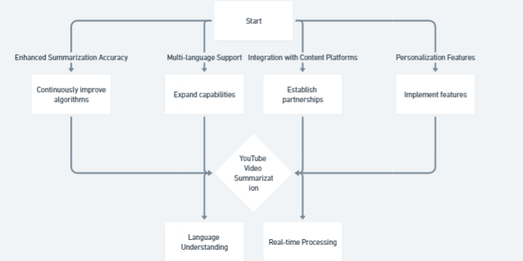
MODELLING

Slide 11
RESULTS
Extensive user testing and feedback validate the effectiveness and usability of our solution across diverse user demographics and content genres.
Metrics such as accuracy, speed, and user satisfaction demonstrate the tangible benefits of adopting the YouTube Video Summarizer.
Ongoing research and development efforts aim to further enhance the capabilities of our platform, ensuring continuous improvement and innovation.

